Slide 1
Predicting the NBA Draft
Zachary Chetchavat
General Assembly – Data Science Winter 2015

Slide 2
Table of Contents
Project Background
Project Question
Data Acquisition and Evaluation
Data Analysis and Model Evaluation
Next Steps
Questions

Slide 3
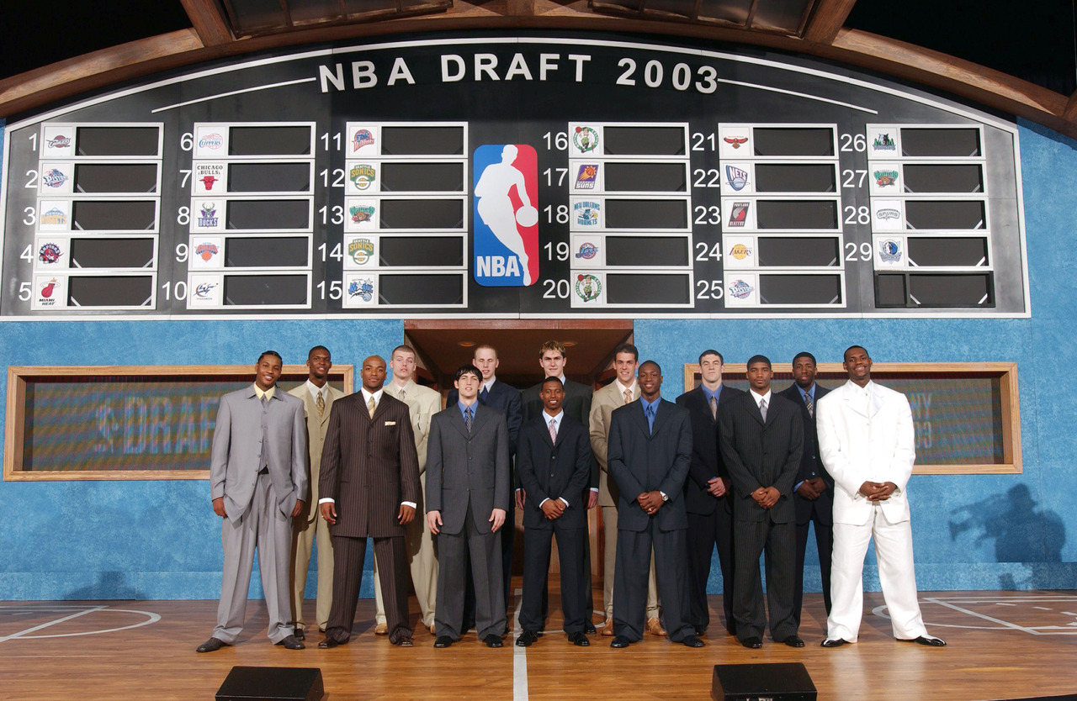
The NBA Draft

Slide 4
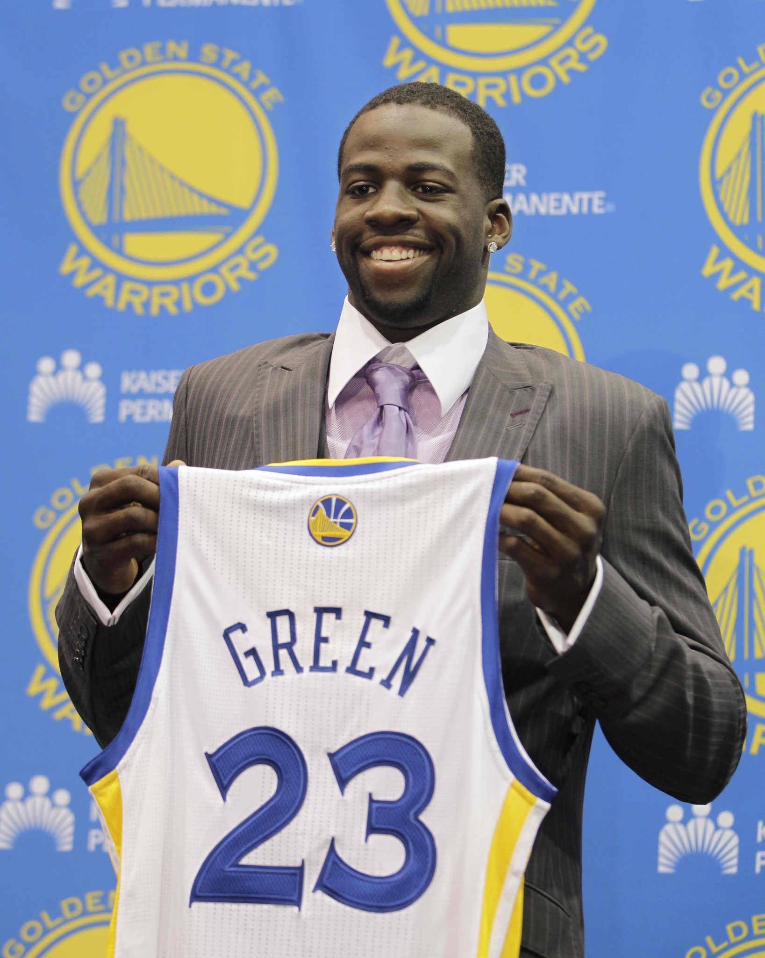
The NBA Draft
Consists of 60 picks between two rounds
Roughly 4500 Division 1 NCAA Basketball Players
Draftees can be College or International players

Slide 5
Project Question
Can we predict if a college basketball player gets drafted into the NBA?

Slide 6
Data Acquisition and Exploration
Problems
College Basketball statistics are very hard to obtain
The scraped data was “dirty”
Draft data and CBB data are from separate sources
Solutions
Found a scraper
Combed through and cleaned the data
Learned to combine them using Python

Slide 7
Data Acquisition and Exploration
 | Not Drafted | Drafted
Not Drafted | 4440 | 0
Drafted | 60 | 0
Accuracy: 98.6%
Error Rate: 1.3%
Sensitivity: 0%
Precision: 0%

Slide 8
Data Analysis and Model Evaluation
Characteristics of the Data:
Continuous Data
  Box Score Data
    Metrics derived from Box Scores
  Height
Categorical Data
  College Division
  College Year
Outcome
  Did they get drafted?
Classifier Models:
Logistic Regression
Decision Tree Classification
  Ensemble Techniques:
    Random Forest Classifier
    AdaBoosting Classifier
    Gradient Boosting Classifier

Slide 9
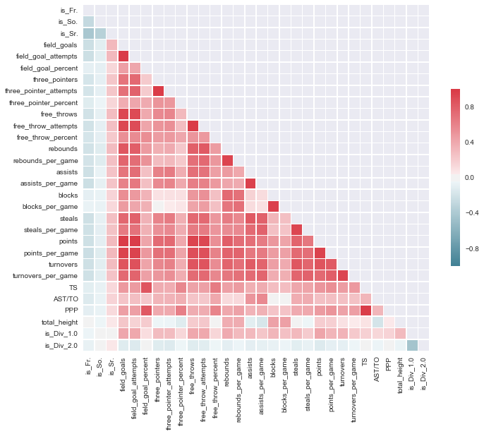
Data Analysis and Model Evaluation

Slide 10
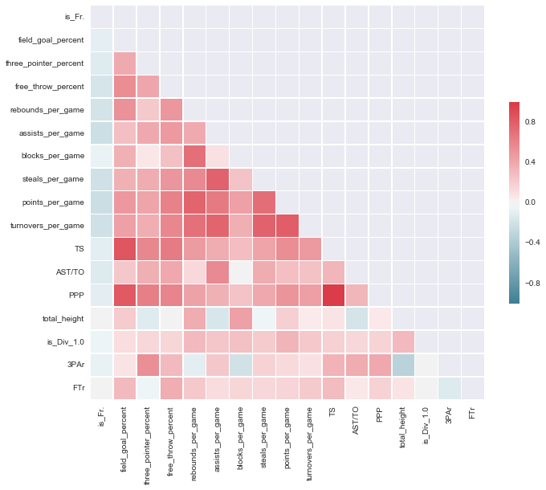
Data Analysis and Model Evaluation

Slide 11
Data Analysis and Model Evaluation
Game Plan:
Create classifiers to evaluate
  Logistic Regression, Random Forest, AdaBoost, Gradient Boosting
Fitting models on balanced datasets
Evaluating models on unbalanced datasets
Assessing issues and next steps

Slide 12
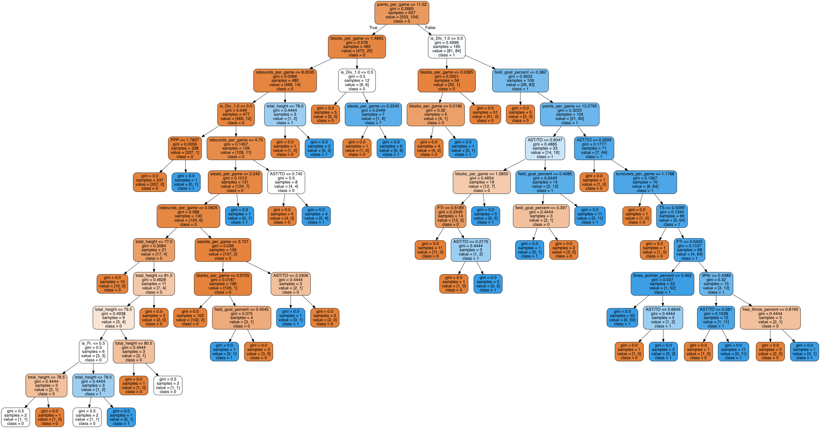
Data Analysis and Model Evaluation

Slide 13
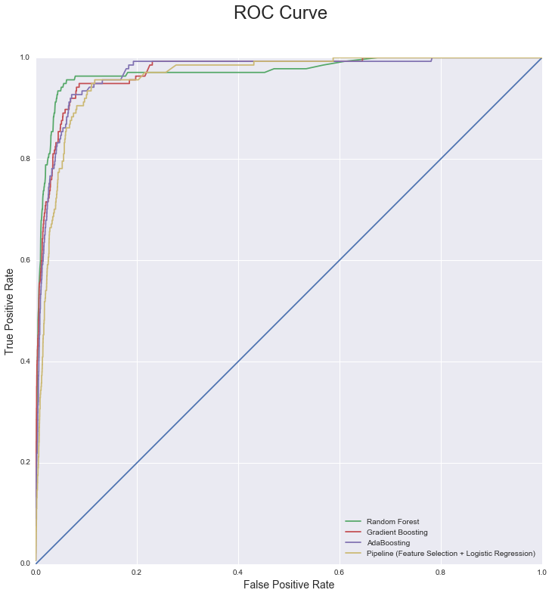
Data Analysis and Model Evaluation

Slide 14
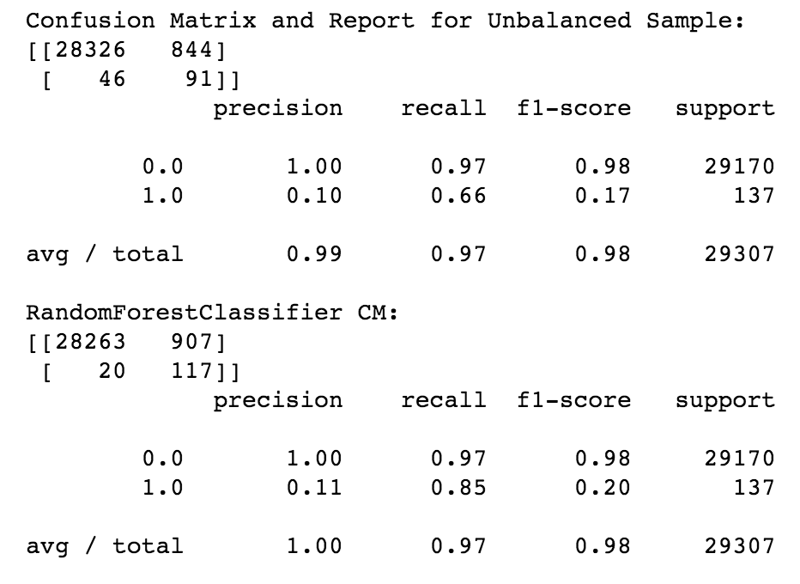
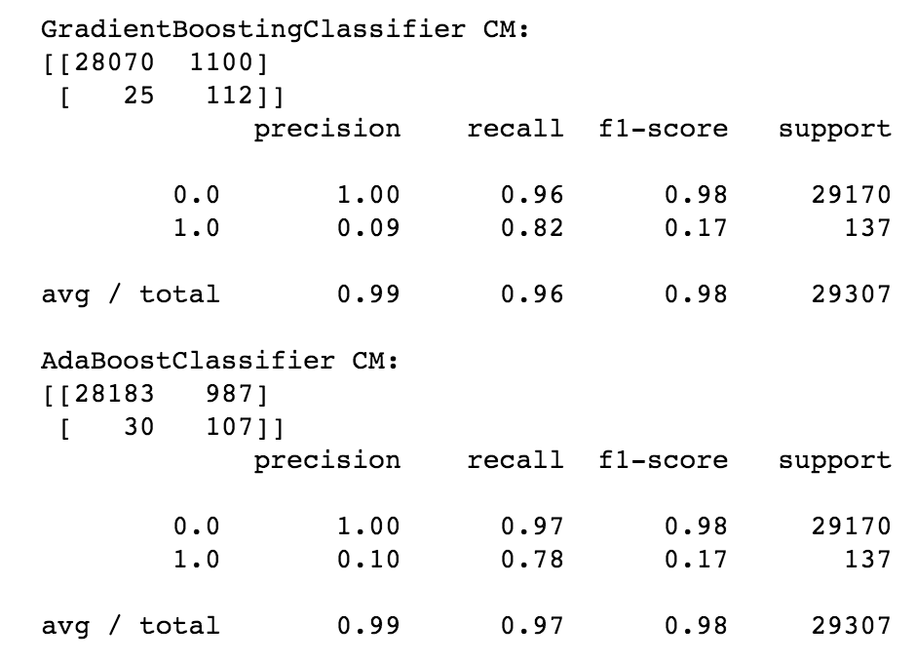
Data Analysis and Model Evaluation

Slide 15
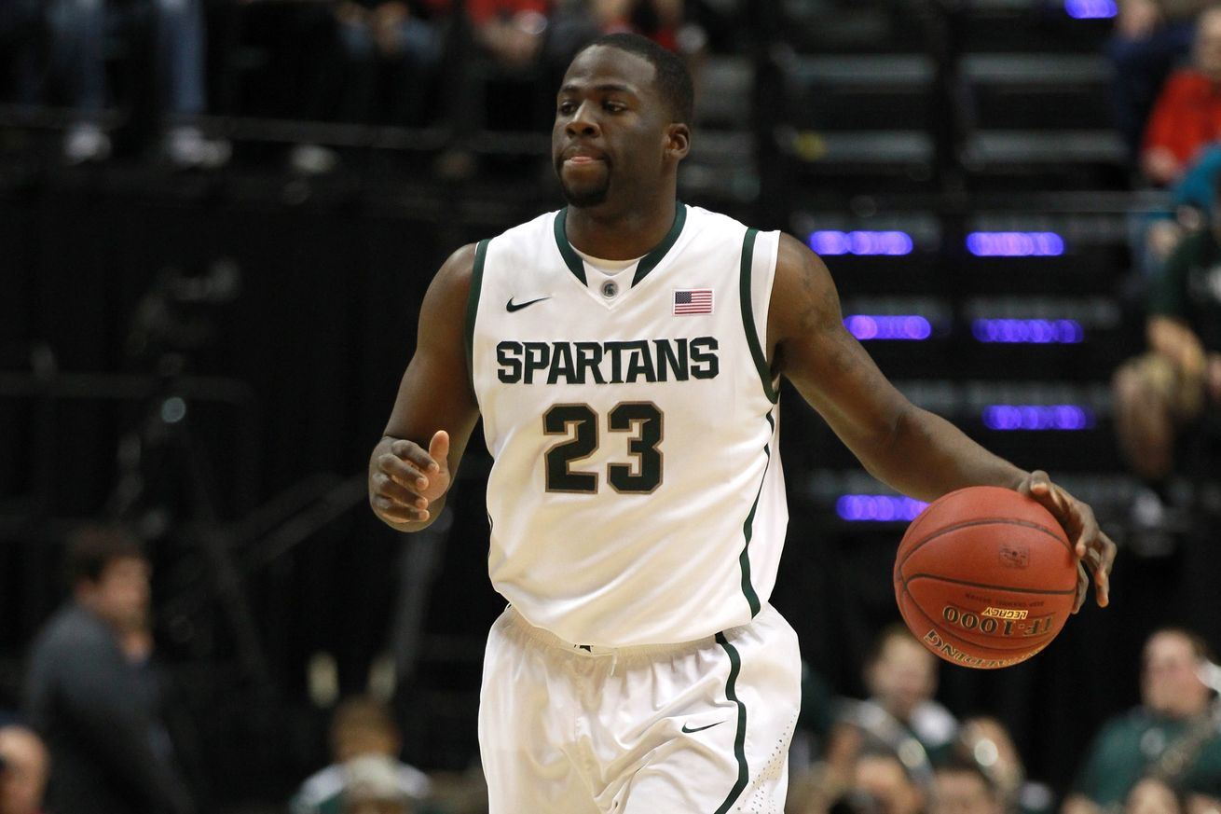
Data Analysis and Model Evaluation
Draymond Green:
2012 NBA Draft
  Round: 2 / Pick: 35
Features:
  Division 1 School
    Senior
  Per Game Stats:
    PTS – REB – AST – STL – BLK - TO
    16.2 – 10.6 – 3.8 – 1.4 – 0.9 – 3.0
  Shooting:
    FG%: 44.9% / 3PT%: 38.8 / FT%: 72.3% / TS%: 54
  Advanced:
    PPP: 0.93 / AST-TO: 1.25 / 3PAr: 28.3% / FTr: 36.6%

Slide 16
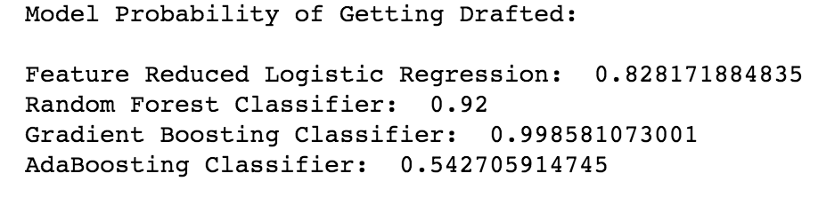
Next Steps
Continue massaging the dataset?
  Limiting to only draft eligible/declared
Acquire more data regarding the draft combine
  Vertical, Wingspan, Shoe Size?
Acquire more robust NCAA data/International Data
  Advanced Stats: Usage, DPM, VORP
  Strength of Schedule
Work on reducing False Positive Rate
  Complement Bayes Theorem
  Creating toy players based on statistical characteristics of drafted players
Expanding analysis scope
  Classifying a 1st round or 2nd round pick
  Additionally classifying undrafted players that are signed (summer league, pre-season, regular season)

